Slide 1
Proxy Final Demonstration
Laura Klions - lk876914
Chase King - ck240617
Nick Maude - nm346217
Jeffery Parker - jp344916

Slide 2
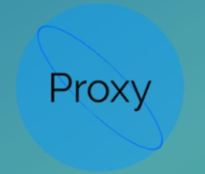
Project Description
Proxy is a Java based Android App developed to help Ohio University students know how busy an area is. It allows student to determine the general traffic in an area, and tell other users when they are occupying a space or study room.

Slide 3
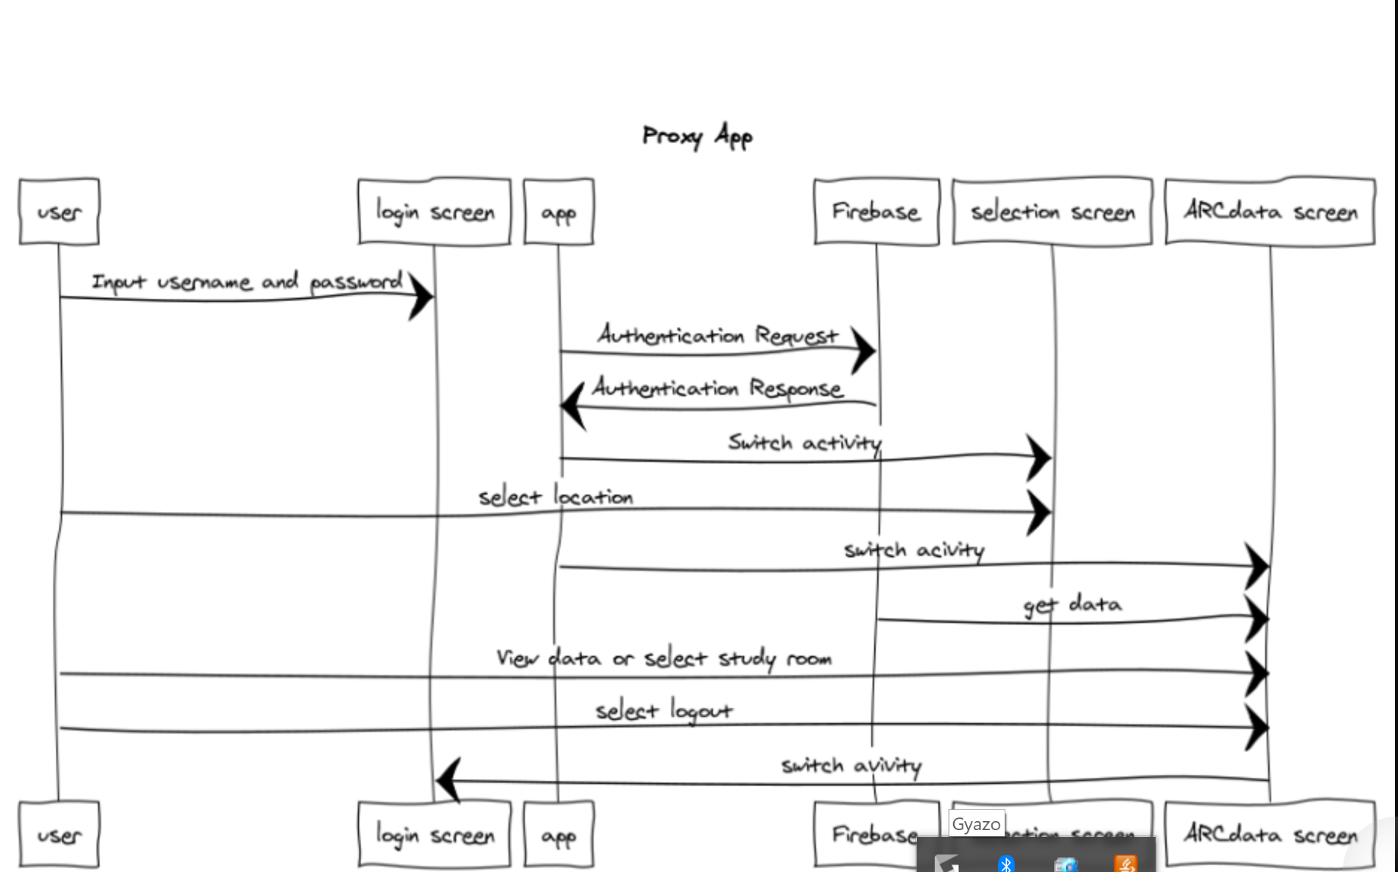

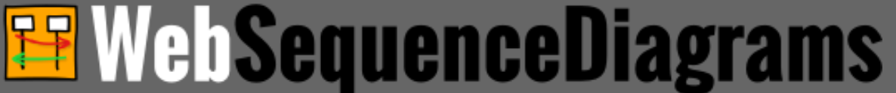
Prototyping tools
WebSequenceDiagram
MockPlus

Slide 4

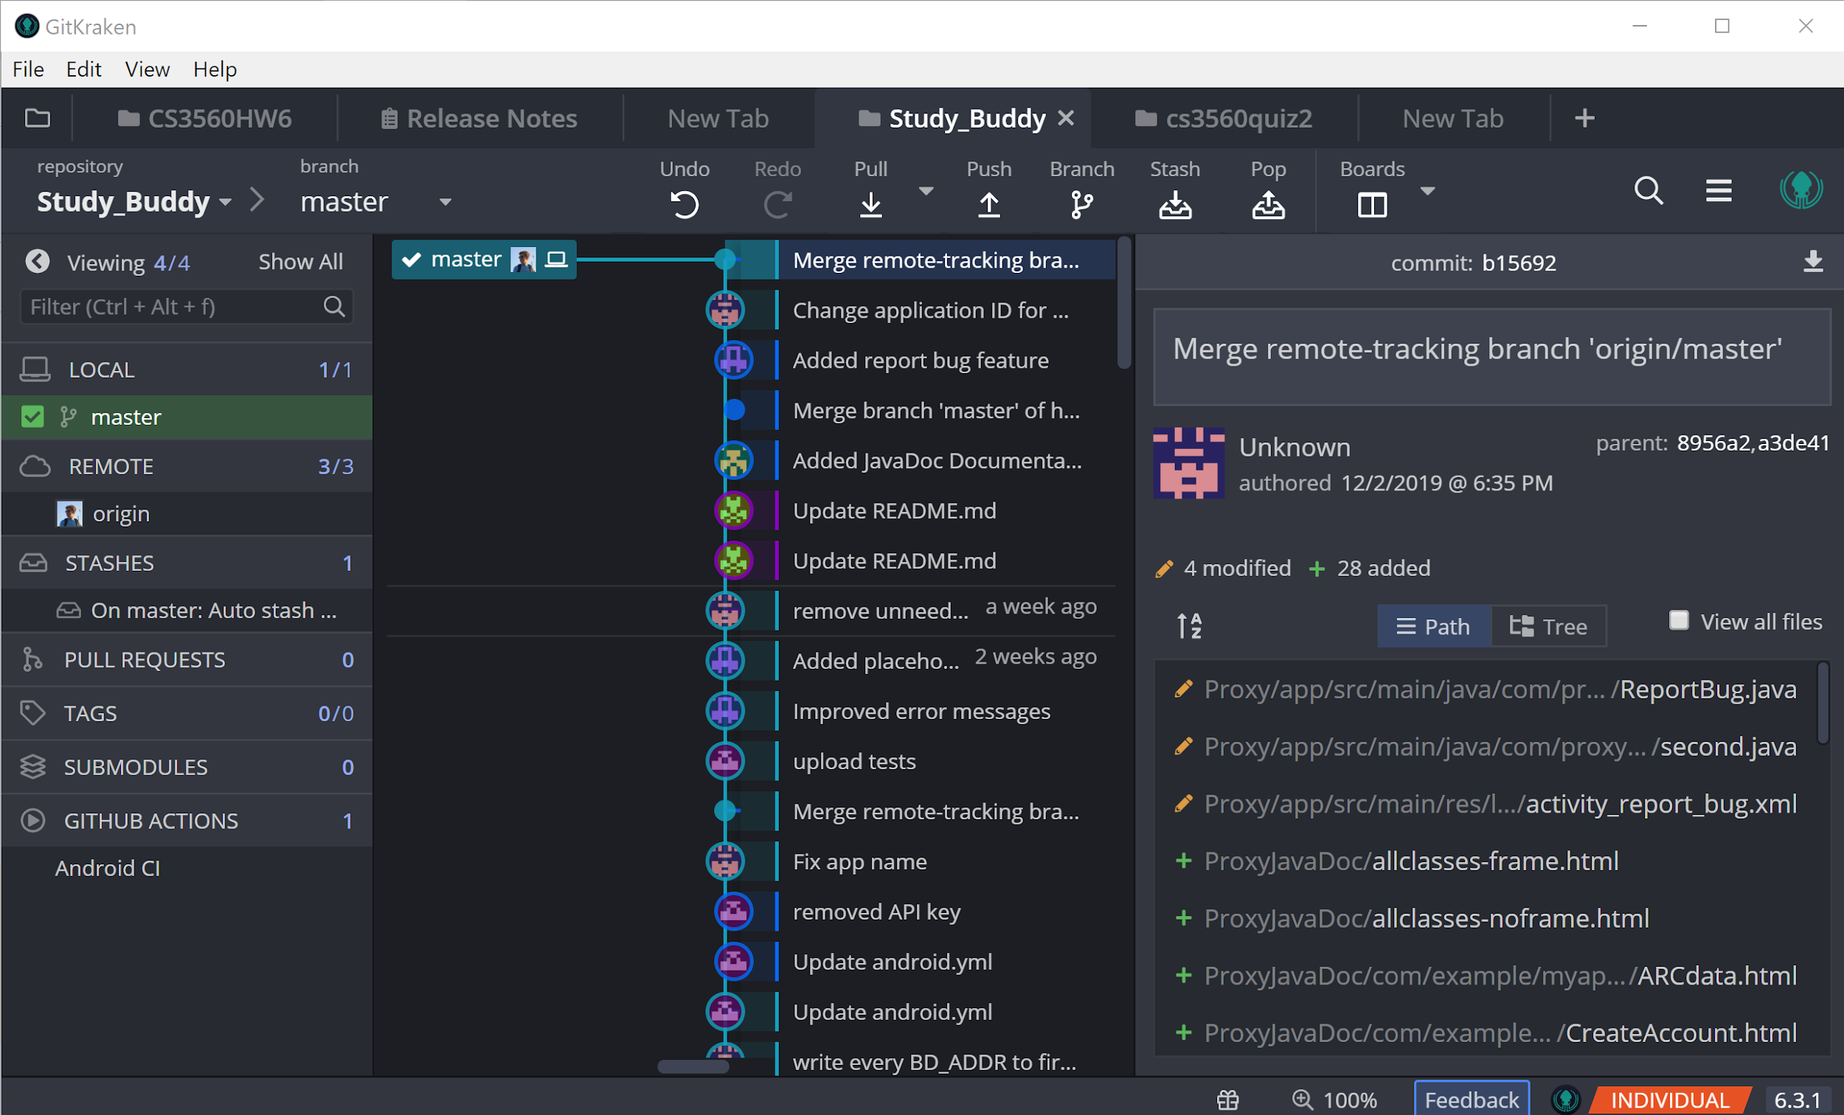
Version Control Tools
Git
Github
GitKraken

Slide 5



Development Tools
Android Studio
Pycharm
Firebase

Slide 6
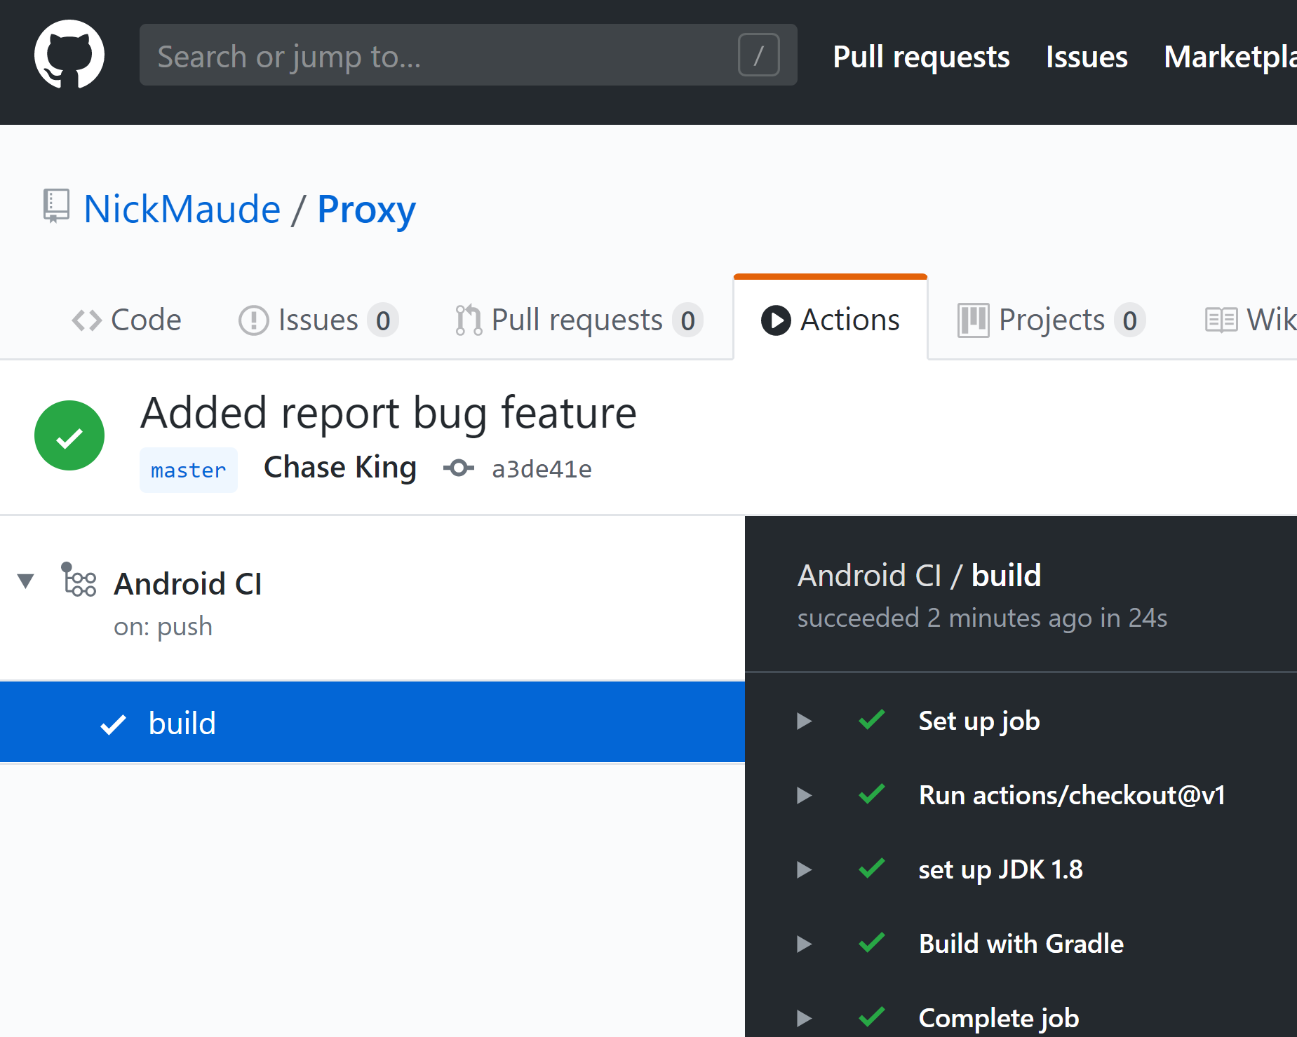
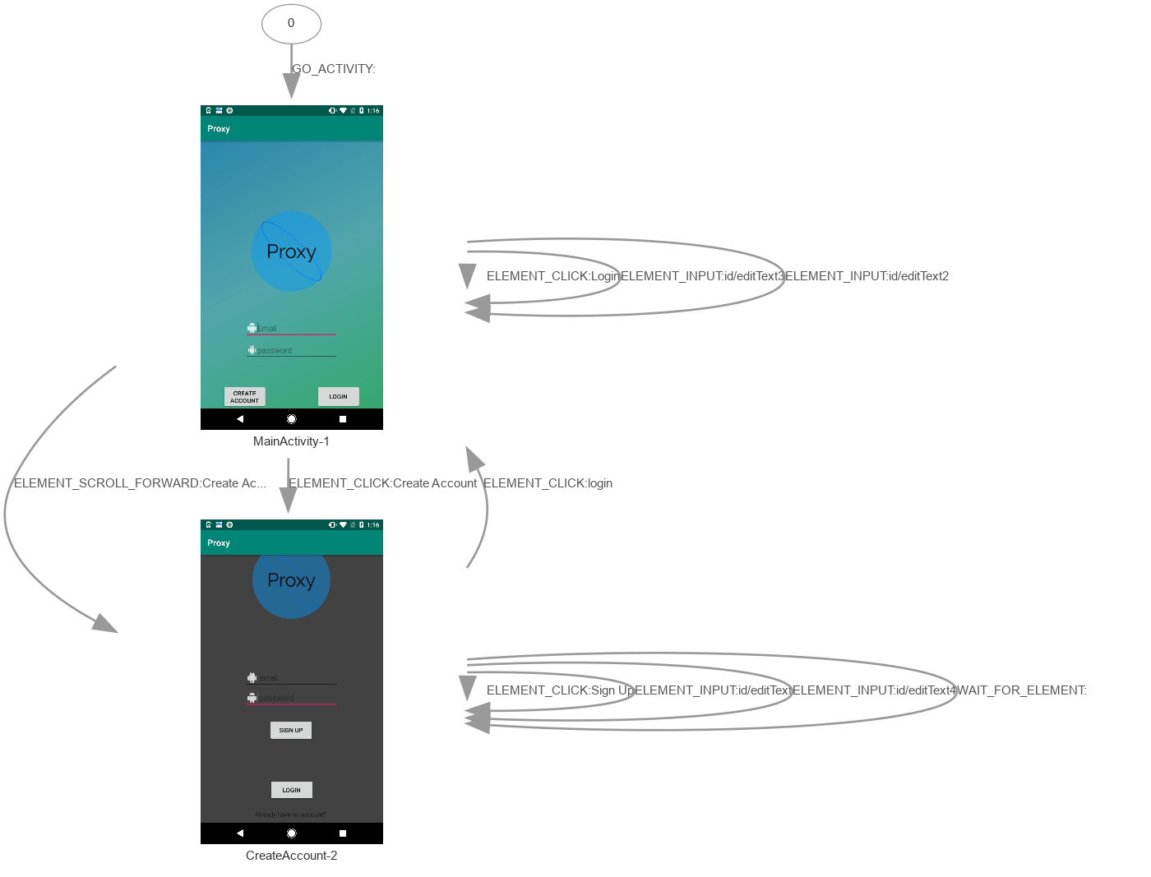
Testing Tools
Android Ci
Firebase test lab
Junit

Slide 7
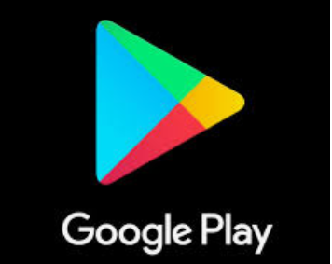

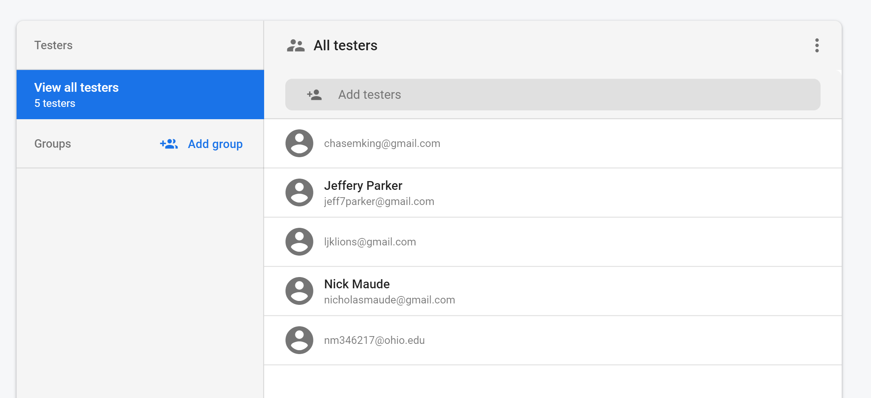
Deployment Tools
Google play store
Firebase App Distribution

Slide 8


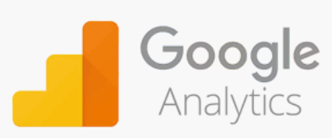
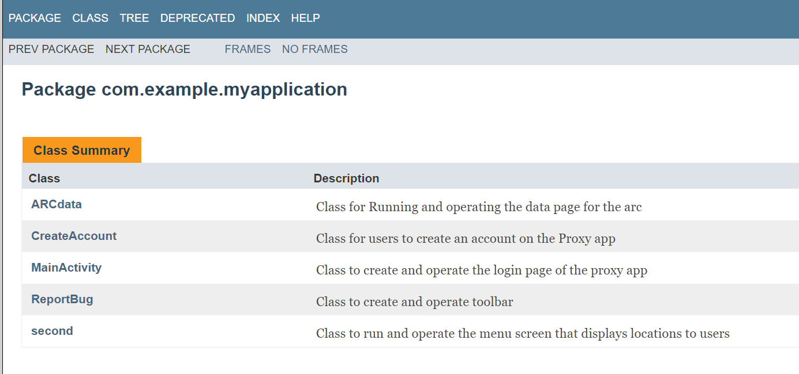
Other Tools
Gradle - Build Automation
JavaDocs - Documentation
Java
Python
gradle

Slide 9
Milestones and Accomplishments
Jeff - Cleaned up some of the user interface, resized buttons to correct proportions and fit on screen, helped Nick work on getting the database to work as intended.
Chase - Added Report Bug feature, changed error messages, edited UI
Nick - Set up firebase to get correctly working, put in app to be reviewed for app store
Laura - Completed Documentation for all classes and methods, Edited GUI, app testing

Slide 10
Roadblocks
The biggest issue for all of us was simply learning Java and Android Studio. For the most part it was new territory and something we had to learn as we developed the app.
Spent too much time planning what we could do down the line which somewhat delayed development of more immediate requirements.

Slide 11
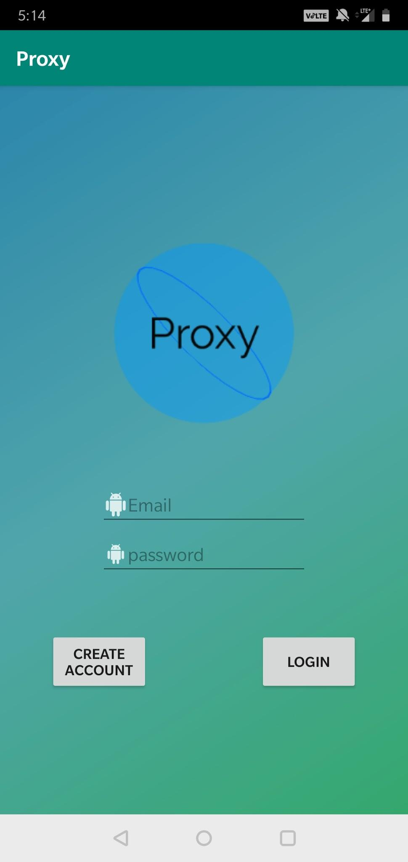
Final Design (Login)
Enter your user information and click login
If no account created, click create account

Slide 12
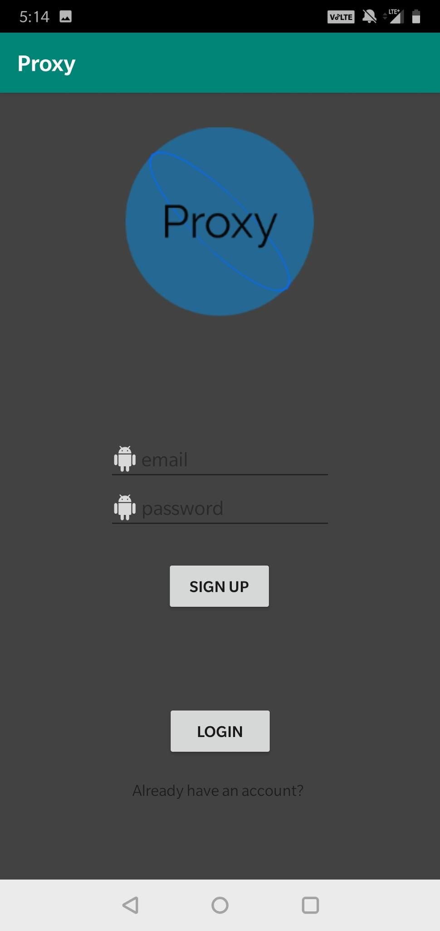
Final Design (Create Account)
Accounts can be created with @ohio.edu emails only
Passwords must be at least six characters
User data is stored and accessed through firebase

Slide 13
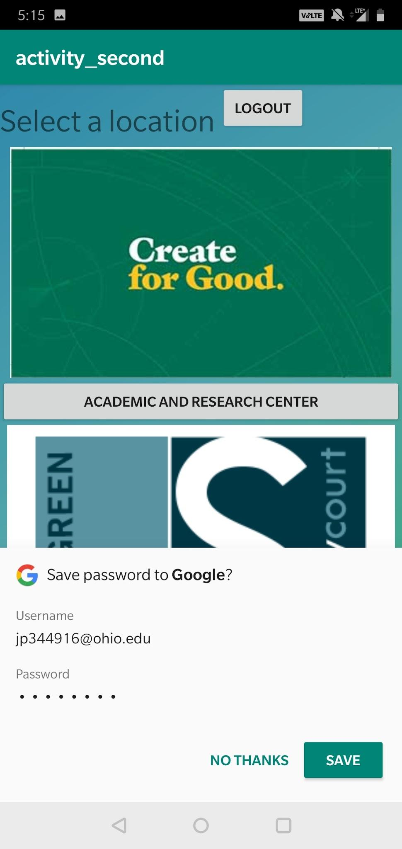
Final Design (Menu)
User can see locations being monitored around campus on the menu page
The Arc is the first working data page
The user can also logout from this screen and return to the login screen

Slide 14
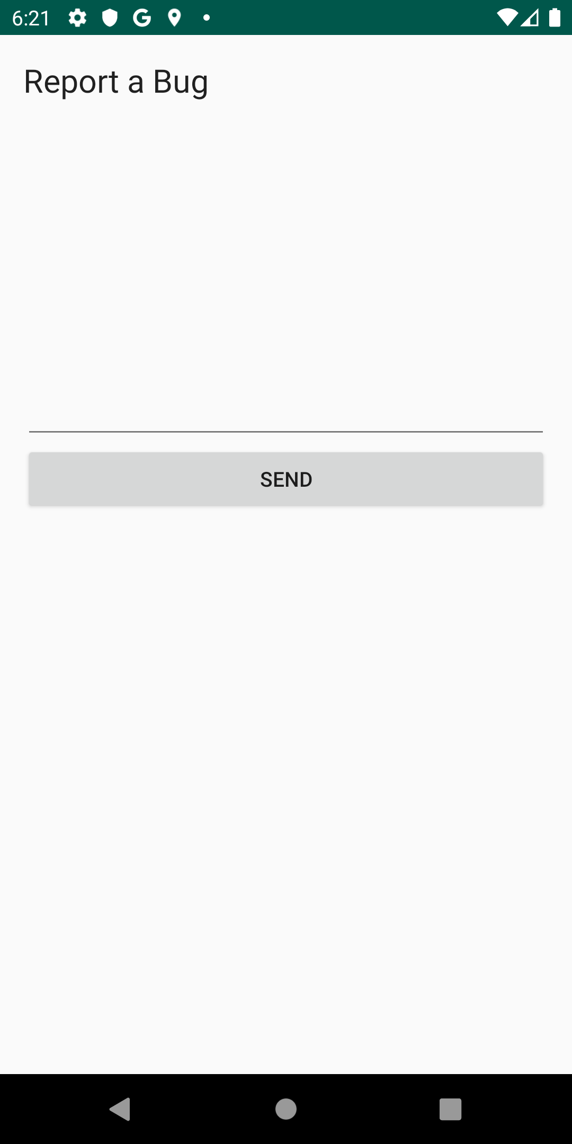
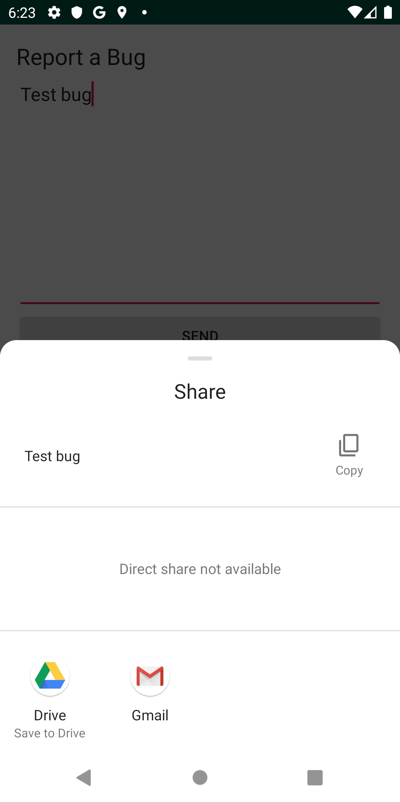
Final Design (Bug)
User has the ability to provide feedback or report an issue with the app which is sent to an email.

Slide 15
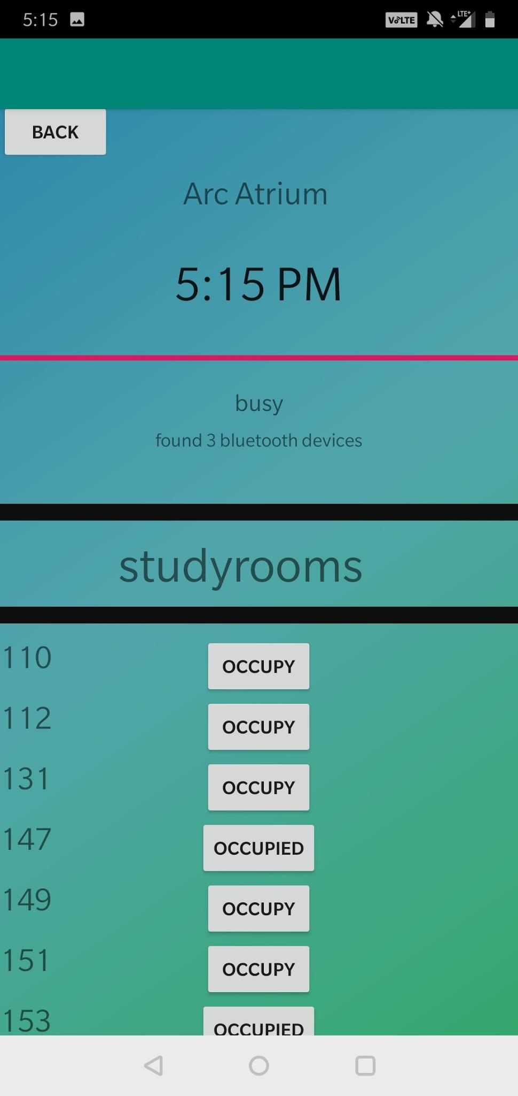
Final Design (Arc Data)
Shows bluetooth devices available to connect
Each room has a corresponding button which
Shows whether it is occupied or not

Slide 16
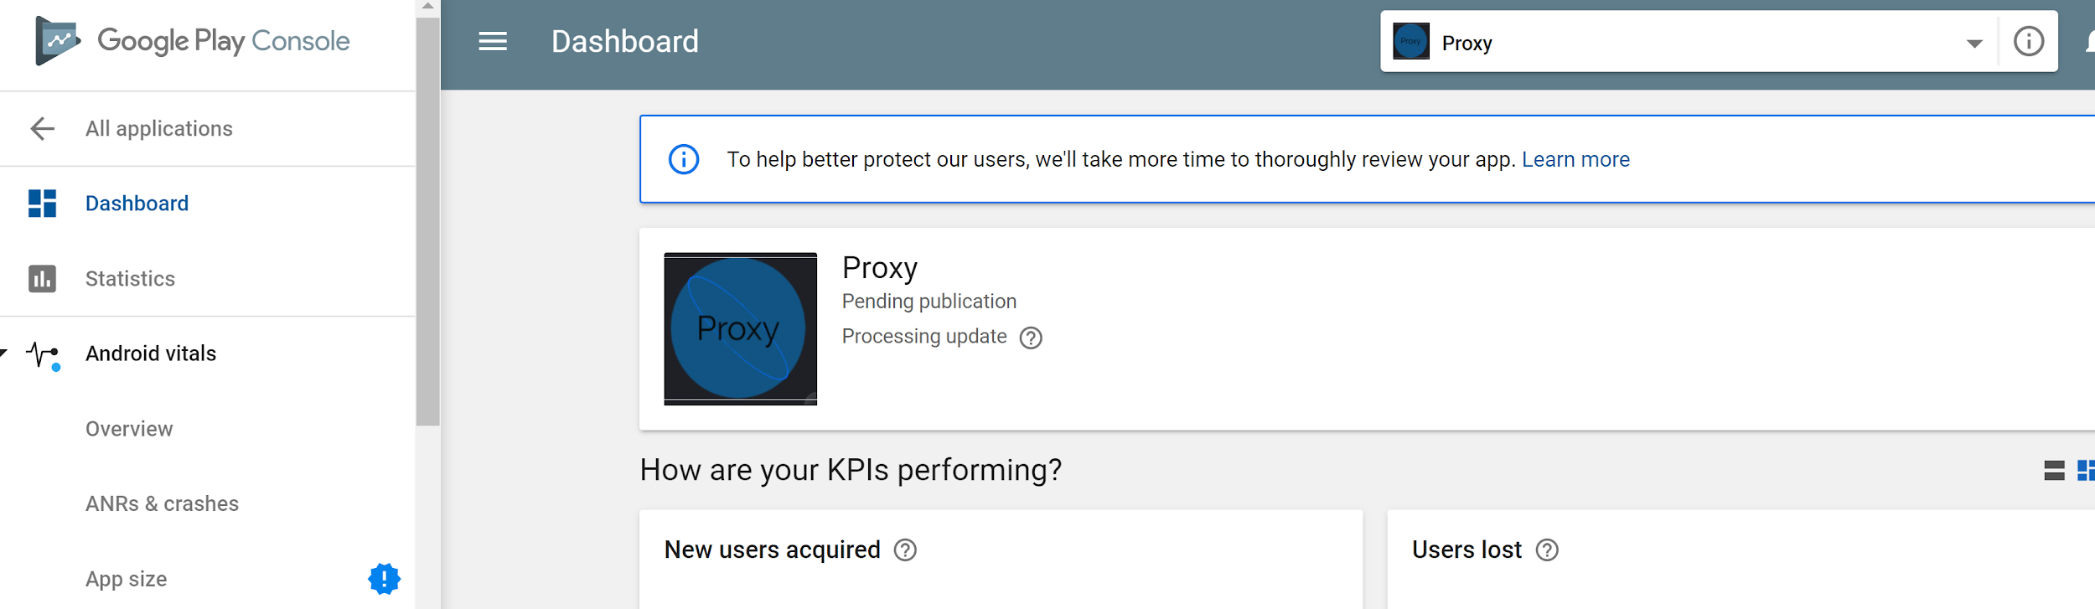
Publishing?
App is Under review on the Google Play Store

Slide 17
Questions?

